Slide 1
ML on Walmart Sales
Case study to help identify the Walmart Team in forecasting the sales for their product categories
Team_6
Abhilash
Aditya
Sai Ramya
Sreekar

Slide 2
Content:
Objective
Data visualization
Data processing and cleaning
ModelBuiltand Evaluation Improvisation toModel

Slide 3
Objective of Current Project is
Predicting “Sales (in Thousand Dollars) ”
The given dataset has following attributes
Sales Data: Train data set (216 rows and 4 features) provided for a period of 2009 -2014
Weather Data: Macro Weather dataset (365/366 rows and 23 features) This data is provided for the period from 2009 to 2016 with the details weather condition.
Macro Economic Data: Macro Economic dataset (96 rows and 18 features) This data is provided for the period from 2009 to 2016 with the details like CPI, GDP, Cotton production, mill usage, unemployment rate etc.
Events and Holiday Data
Attributes Details : “Attributes Description.xlsx” This has the details of attributes for the datasets cited above
Data contains many null/zero values
The objective is to forecast the 'Sales(In ThousandDollars)' in test dataset for the year 2015.
The error metric is the RMSE (Root Mean Squared Error).

Slide 4
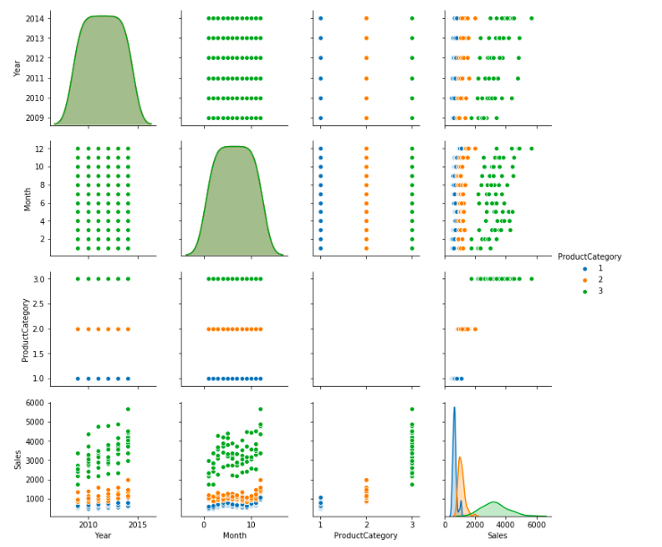
Data Visualization
Train Dataset
Product Category
1: Men Clothing
2: Other Clothing
3: Women Clothing

Slide 5
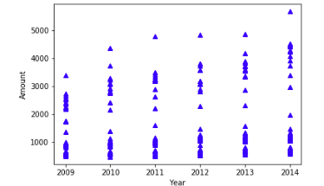
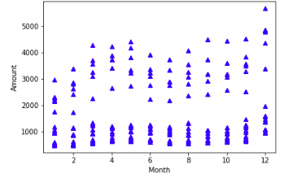
Sales report

Slide 6
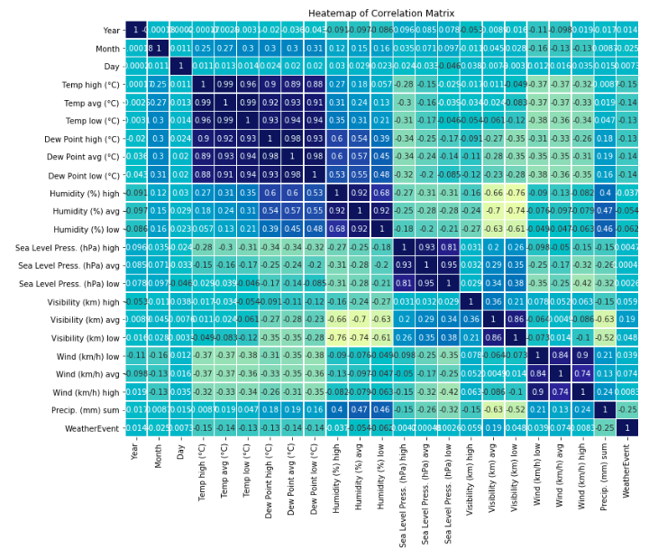
Weather Dataset
Heatmap of the
Correlation matrix

Slide 7
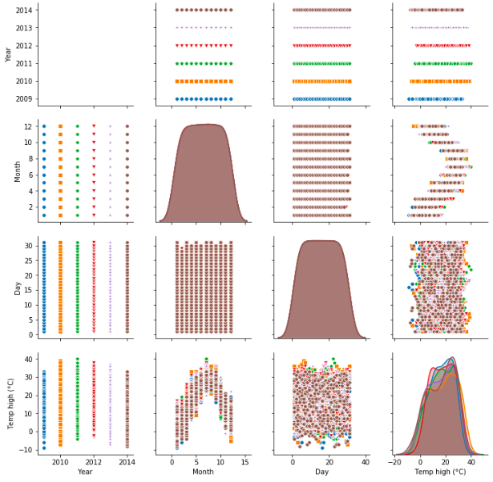
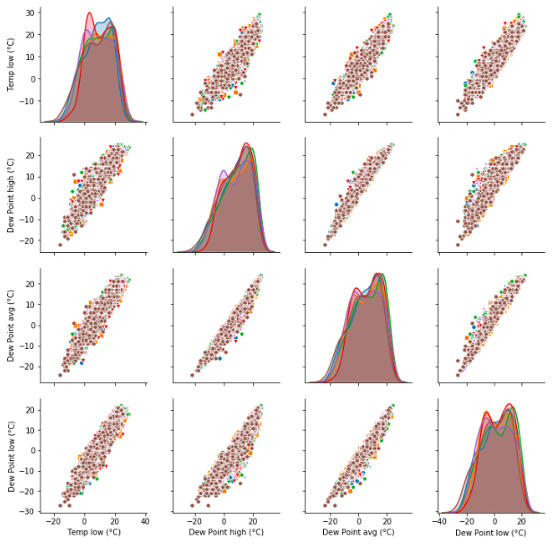

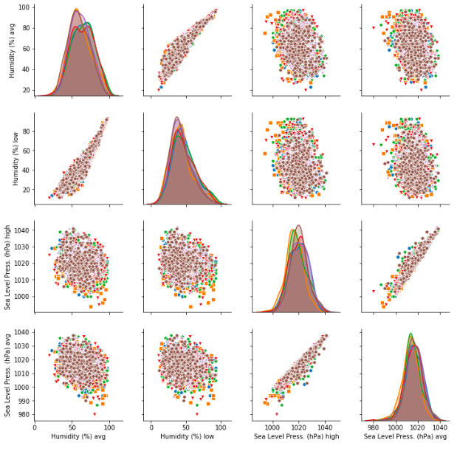
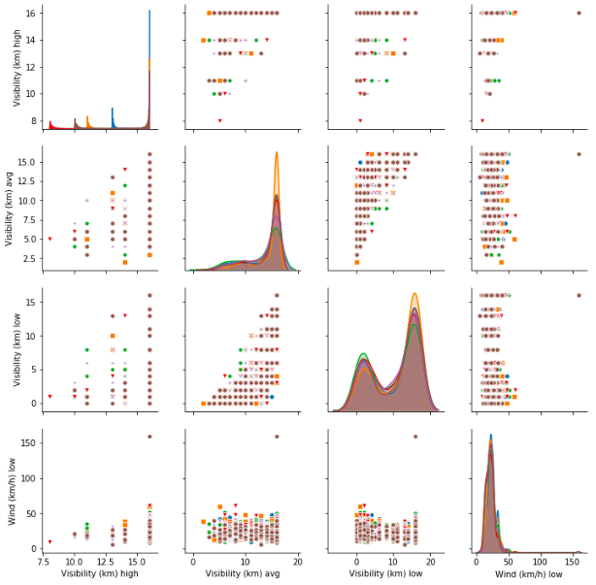
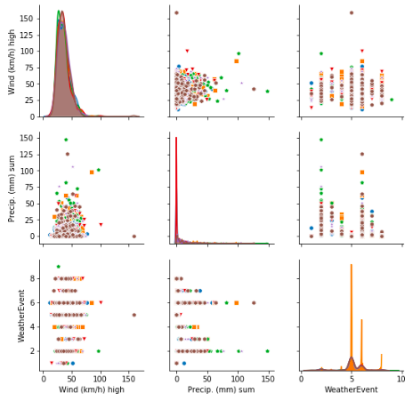

Slide 8
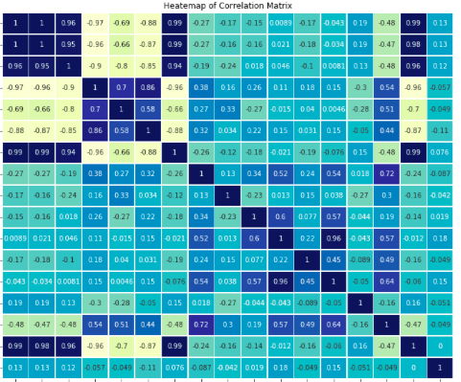
Micro Economic Data
Heatmap of the
Correlation matrix

Slide 9
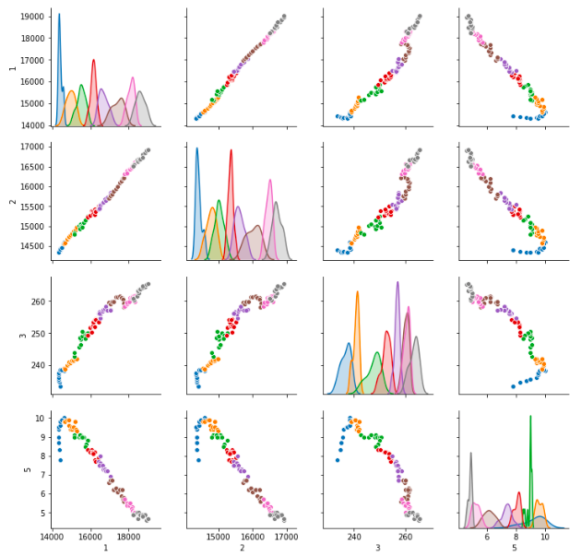
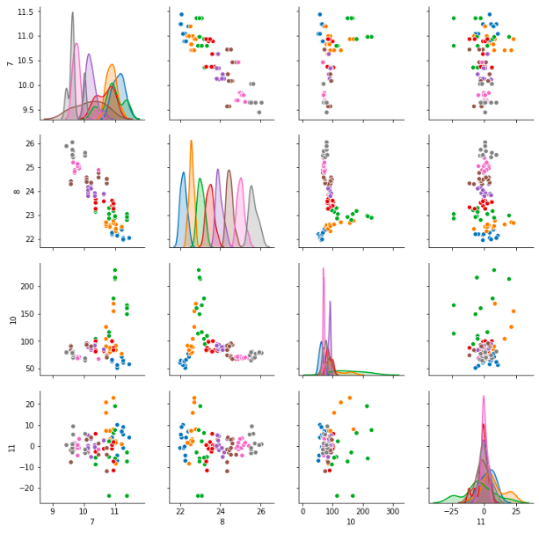
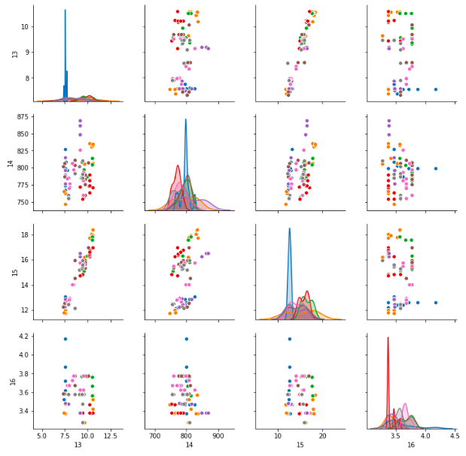
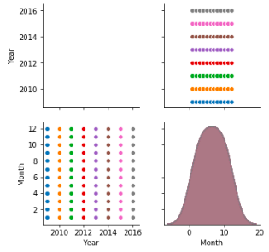


Slide 10
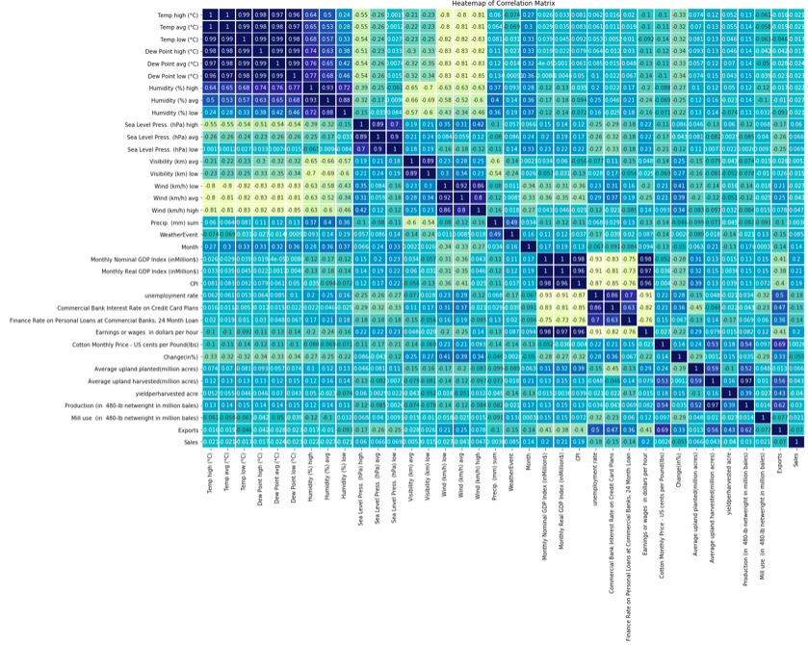
Full Merged
data
Heat map

Slide 11
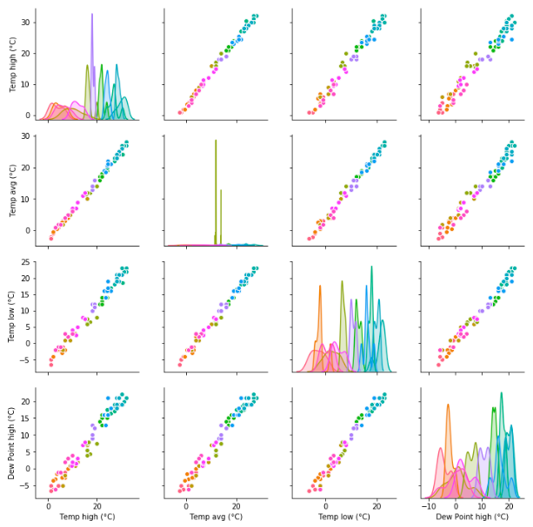
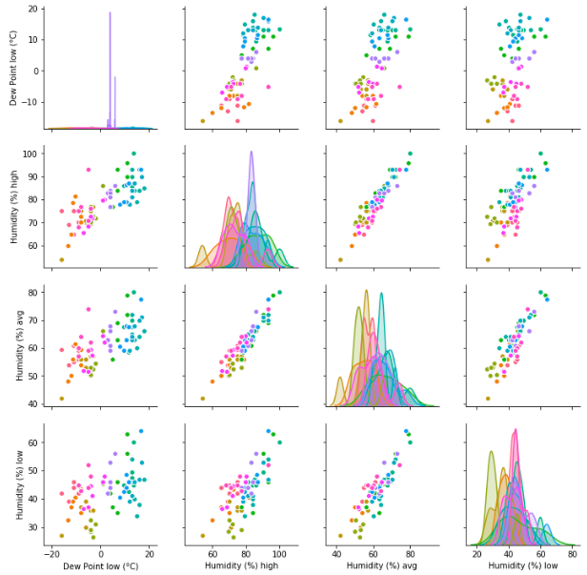

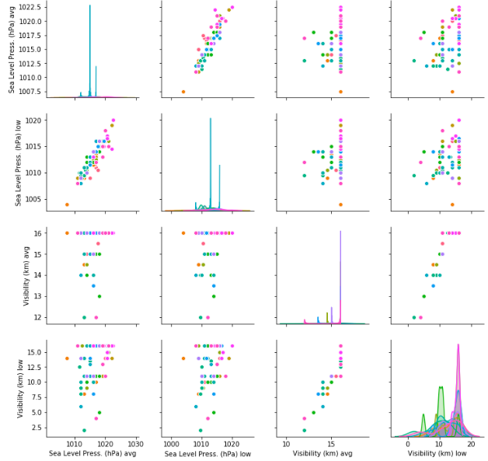
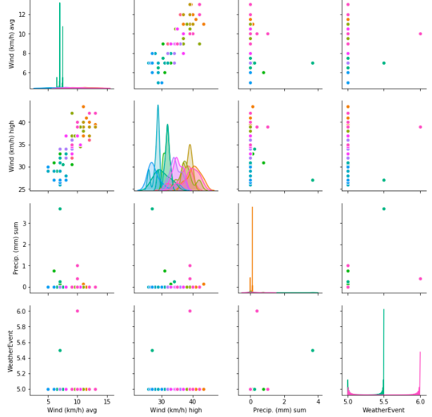
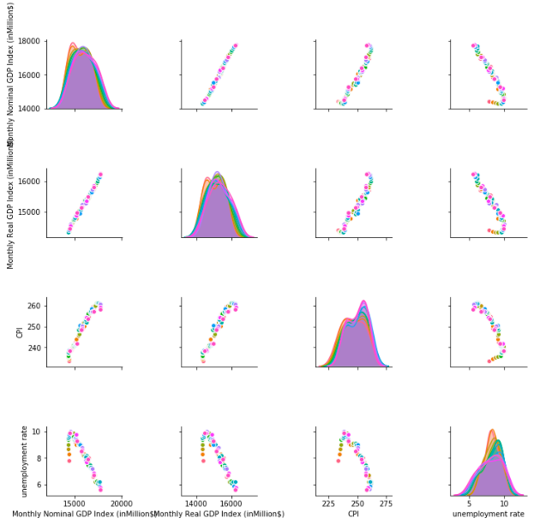

Slide 12
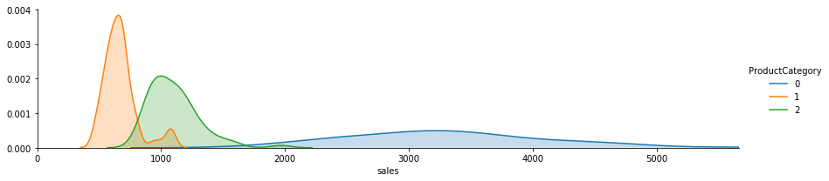
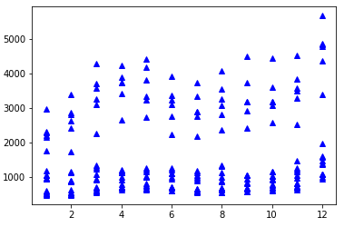
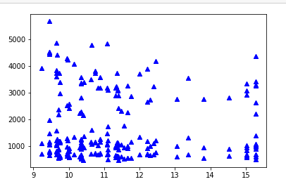
Sales Vs Product Category
Sales are highly correlated with product category
Month Vs sales Exports

Slide 13
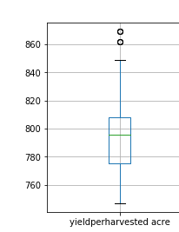
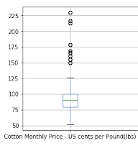
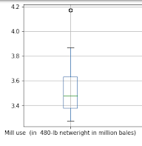
Outliers

Slide 14
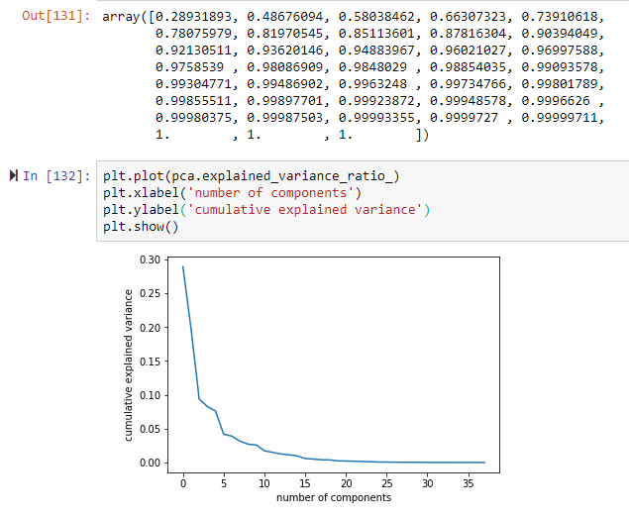
PCA Analysis
85% proportion of variance
Is explained by 8 components

Slide 15
Module Build and Evaluation
RMSE is the important aspect to test the model performance
We had tried the below models in the stipulated time
Model | RMSE Vale
DecissionTreeRegressor | 1311
KNN Regressor | 1220
Linear Regression | 693.81
HuberRegressor | 1381
GaussianProcessRegressor | 1289

Slide 16
